Slide 1


"Namami Gange": Reviving the Lifeline of India
The "Namami Gange" program aims to revitalize the River Ganges, a sacred and essential lifeline for millions of Indians. This initiative, spearheaded by the Indian government, focuses on cleaning and conserving the river's ecosystem, ensuring a healthy and sustainable future for the Ganga.

Slide 2
Current Status and Achievements
Waste Management
Riverbank Rejuvenation
Public Awareness
Significant progress in waste management through improved sewage treatment infrastructure, constructing new sewage treatment plants, and promoting scientific waste disposal methods.
Reforestation efforts along the riverbanks to restore vegetation and enhance the river's natural filtration process, improving water quality and ecological balance.
Extensive public awareness campaigns have raised awareness about the importance of the Ganga and encouraged responsible practices towards environmental conservation.

Slide 3
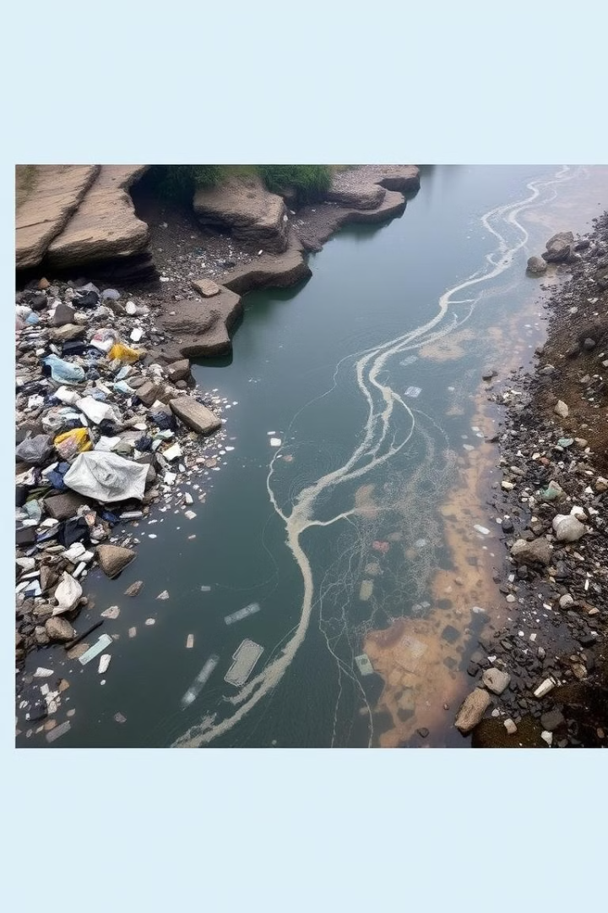
Challenges in Cleaning the Ganga
Industrial Pollution
Urbanization and Population Growth
Uncontrolled industrial discharge into the river remains a significant challenge, contaminating the water and impacting the ecosystem.
Rapid urbanization and population growth along the river's banks are putting immense pressure on sanitation infrastructure, contributing to pollution.
Lack of Public Participation
Despite awareness campaigns, challenges remain in securing active public participation and promoting responsible practices for the river's conservation.

Slide 4




Innovative Computer Science Solutions
IoT Monitoring
AI Waste Management
Real-time monitoring of water quality and pollution levels to detect and address issues promptly.
Optimizing waste collection and disposal, identifying sources of pollution, and predicting potential environmental threats.
Blockchain Transparency
Ensuring transparent allocation and utilization of funds for the "Namami Gange" program.

Slide 5
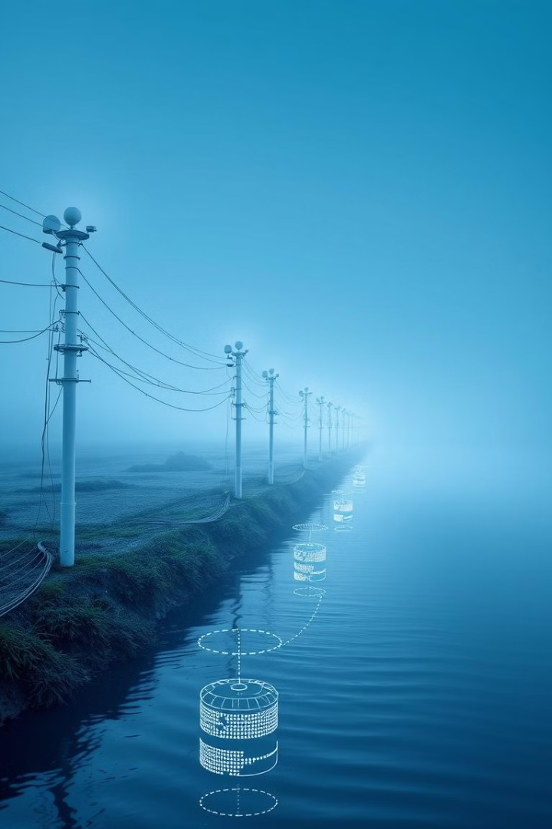
Harnessing the Internet of Things (IoT) for Real-Time Monitoring
1
Sensors
Deployment of sensor networks to continuously monitor water quality parameters like pH, dissolved oxygen, and pollutant levels.
2
Data Transmission
Real-time data transmission via wireless networks to a central monitoring system, allowing for immediate analysis and intervention.
3
Alert System
Automated alerts triggered when pollution levels exceed pre-defined thresholds, enabling quick responses and mitigation efforts.

Slide 6




Leveraging Artificial Intelligence for Efficient Waste Management
Waste Classification
AI-powered algorithms to classify waste materials, facilitating efficient sorting and recycling processes.
Pollution Source Identification
AI analysis of data from sensors and other sources to identify specific sources of pollution, enabling targeted interventions.
Predictive Modeling
AI algorithms to predict potential pollution events based on historical data and environmental factors, enabling proactive measures.

Slide 7



Blockchain Technology for Transparent Fund Allocation
Immutable Records
1
Secure and tamper-proof records of funds allocated and utilized, ensuring transparency and accountability.
Real-Time Tracking
2
Real-time tracking of fund flow from allocation to project implementation, allowing for efficient monitoring.
Public Auditing
3
Public access to blockchain data, enabling independent audits and verification of financial transactions.

Slide 8
Conclusion and Future Outlook
Sustainable Solutions
1
The "Namami Gange" program is paving the way for a sustainable and holistic approach to river conservation.
Technology Integration
2
The use of cutting-edge technology is crucial in addressing complex environmental challenges.
Future Directions
3
Continued research and development are needed to refine and expand the application of technology for river revitalization.

Slide 9
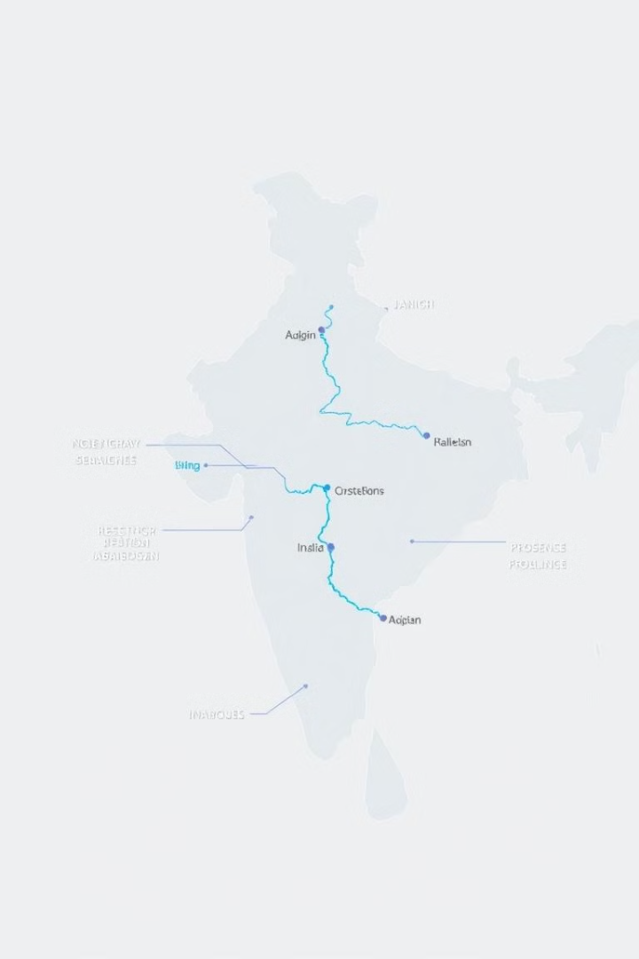
Current Progress and Budget
2500
1500
Crore Rupees
Crore Rupees
Total allocated budget for the "Namami Gange" program to date.
Amount invested in sewage treatment infrastructure and waste management solutions.
600
400
Crore Rupees
Crore Rupees
Funds allocated for riverbank rejuvenation and afforestation projects.
Budget dedicated to public awareness campaigns and community engagement initiatives.

